Slide 1
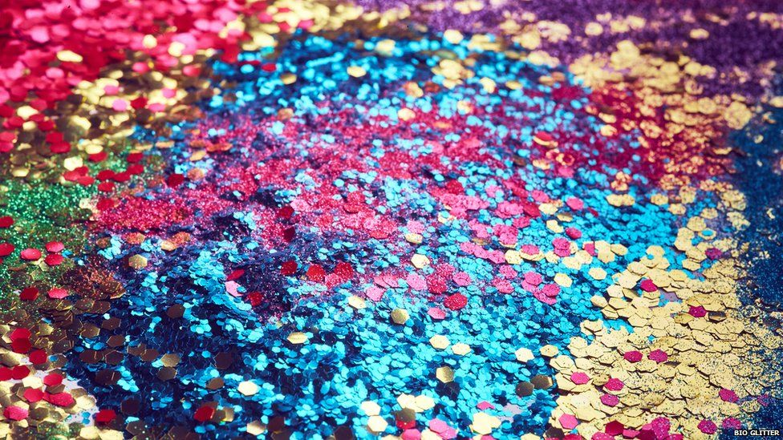
CARNIVAL AT SAN DIEGO
CALIFORNIA

Slide 2
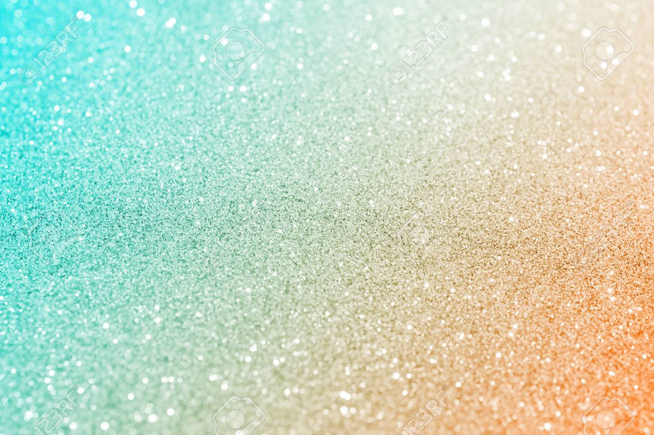
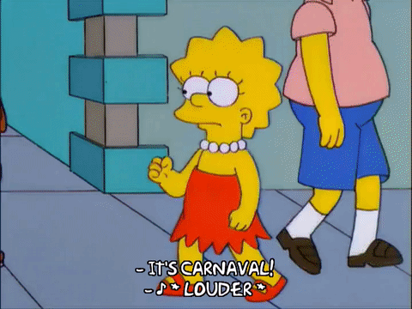
Carnival inSan Diego
SINCE WHEN? Created in 1979
WHERE? In the main street of San Diego
DURATION? 2 Days
It’s the largest multicultural celebration on the west coast

Slide 3
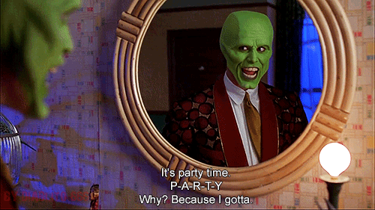
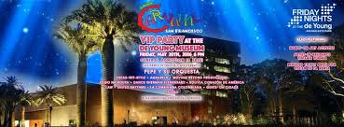
VIP party at the «de young museum»
IT’S LIKE THE PRE-PARTY,
WHAT? A PREVIEW OF THE CARNIVAL
WHEN? A WEEK BEFORE THE CARNIVAL
WHERE? AT DE YOUNG MUSEUM

Slide 4
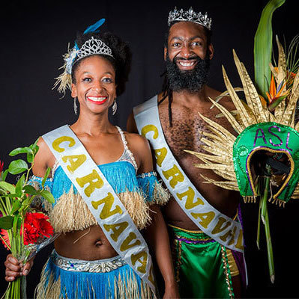
King and queen competition
It starts a month before carnival
IF YOU WANT TO WIN YOU HAVE TO …
Have the most amazing costume
You can become in the official ambassadors of the carnival
And win a 500$ cash prize
LATEST WINNERS

Slide 5
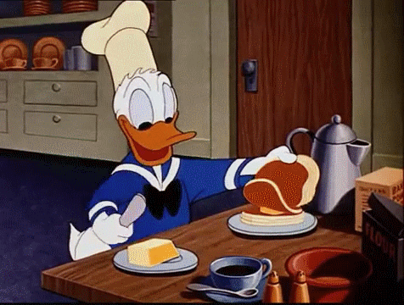
Season Kick-Off: Fat Tuesday
OFFICIAL MEAL
It’s the last day before lent.
People do whatever they want, dance and eat until they can.

Slide 6
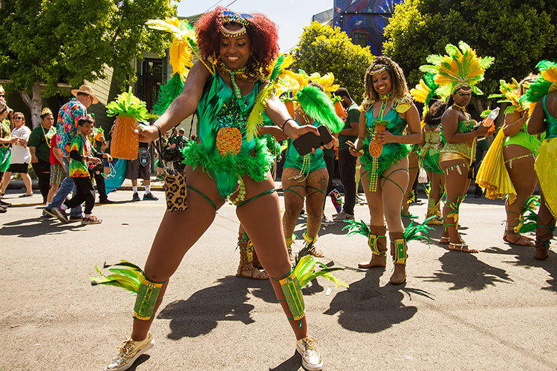
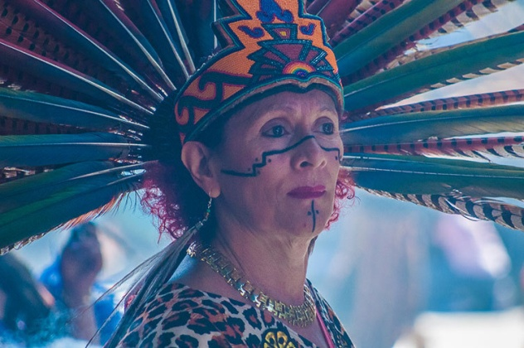
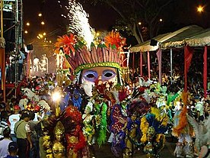
This year at San Diego’s carnival…
It’s the 40 aniversary of the carnival
The topyc of this year is «LA CULTURA CURA or CULTURE HEALS»
https://youtu.be/-Da3qpm_ctM

